Slide 1

Progress Update on 3D Scanner System for 3D Printer Project
Progress report
15.07.2024

Slide 2
Progress So Far
Extracted pixel displacement from each frame
Dynamically reconstructed the reference line from image frame
Created depth match for individual frames

Slide 3
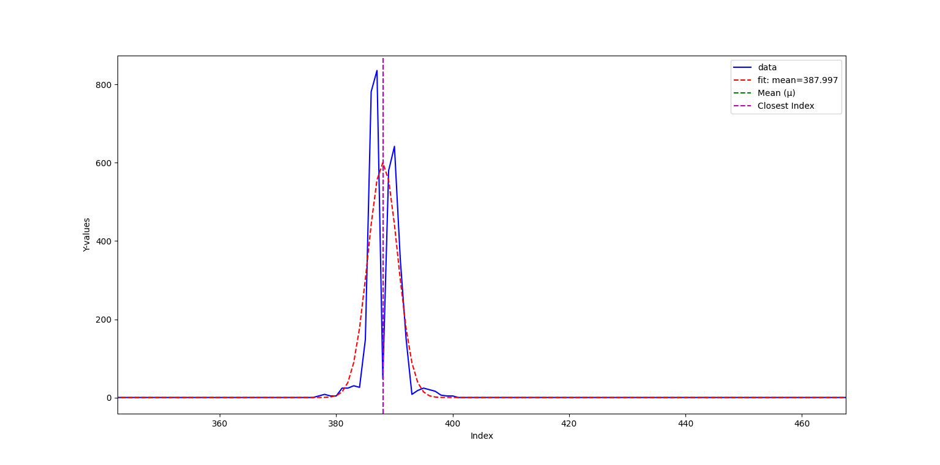
Progress
From the edge trace from Sobel X gradient method, the laser line was recovered in the image

Slide 4
Progress
From the recovered laser line reference line trace, tasks become to recover the laser trace falling on the object and the reconstructing the reference laser line
Laser trace falling on the object can be recovered by considering a breakpoint pixel displacement
Reference line can be reconstructing using pixel interpolation

Slide 5
Progress
Interpolation with corresponding results
S. No | Interpolation Method | Variance
1 | Linear Interpolation | 22.75110
2 | Polynomial Interpolation (deg=2) | 23.7864
3 | Polynomial Interpolation (deg=3) | 21.5395
4 | Cubic Spline Interpolation | 33.7757
5 | Nearest Neighbour Interpolation | 22.75110

Slide 6
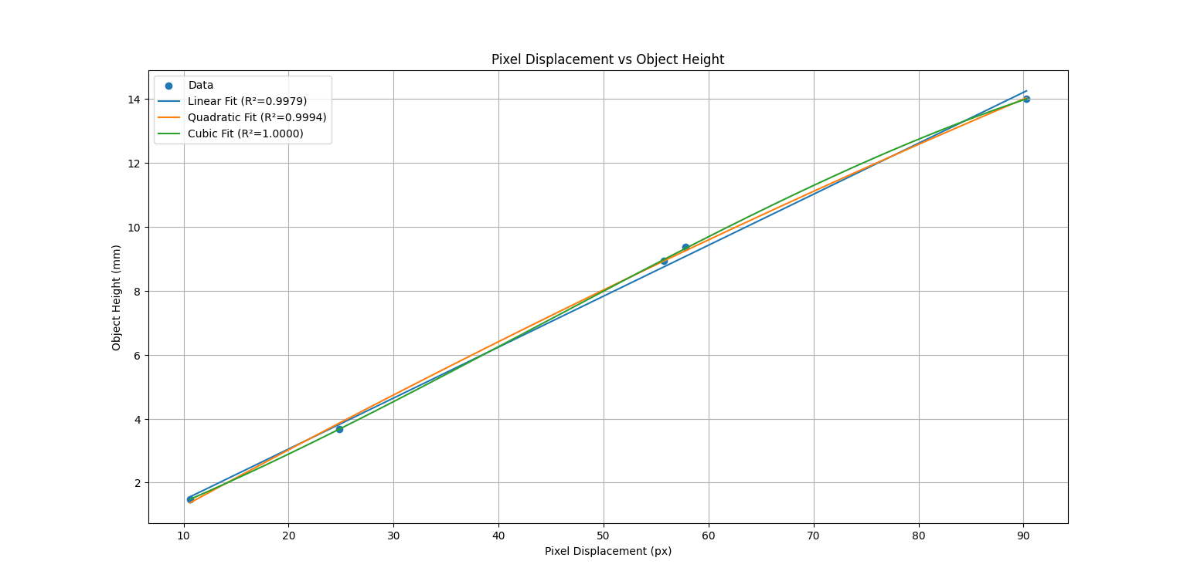
Progress
By recreating the reference line dynamically, it can be observed pixel displacement with the height of the scanned object

Slide 7
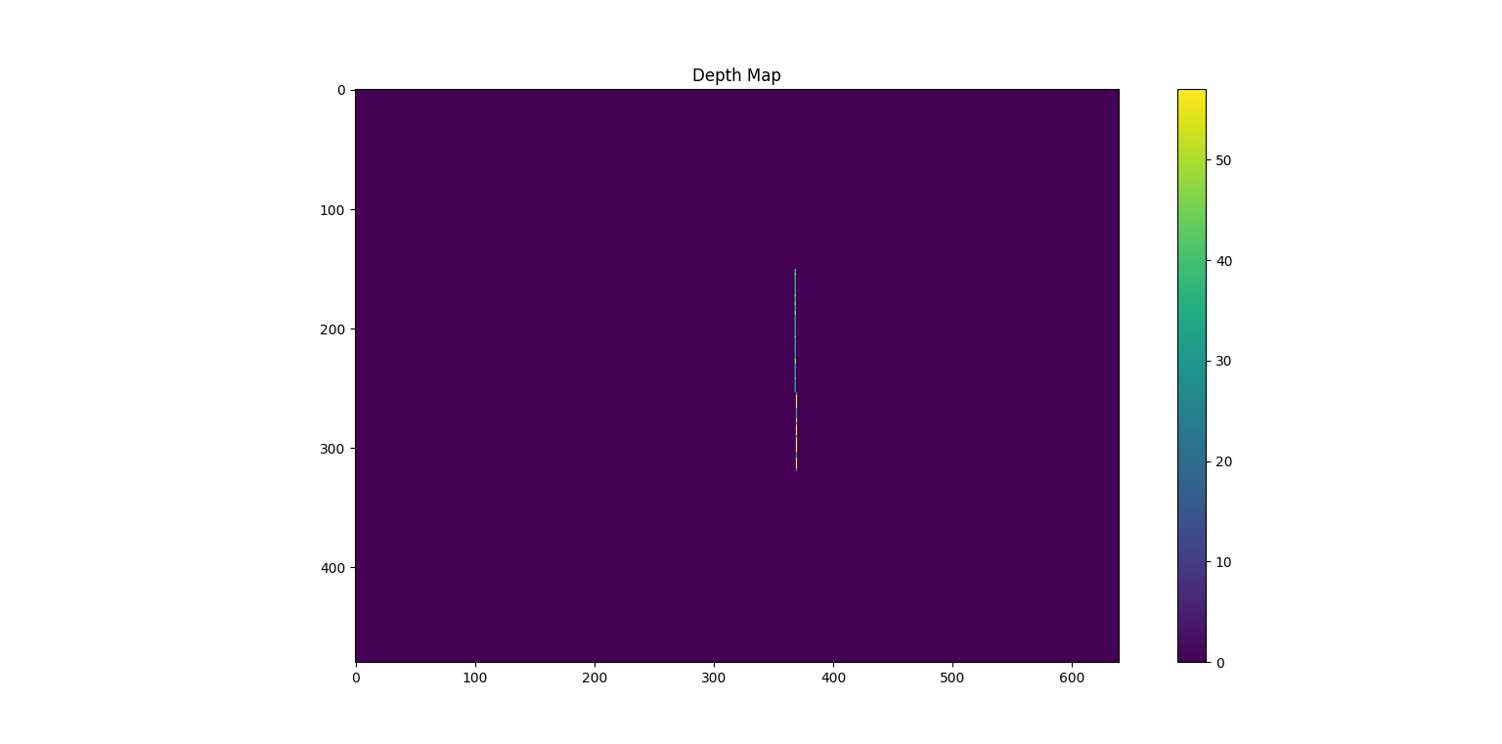
Progress
From pixel displacement the depth map of the frame is calculated

Slide 8
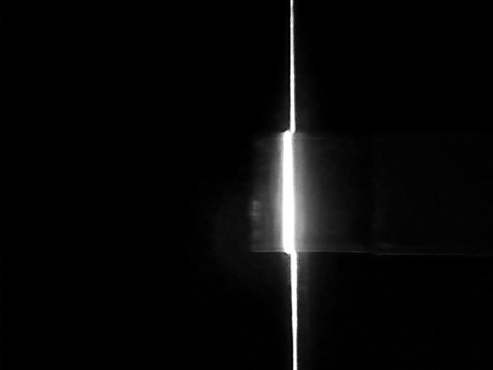
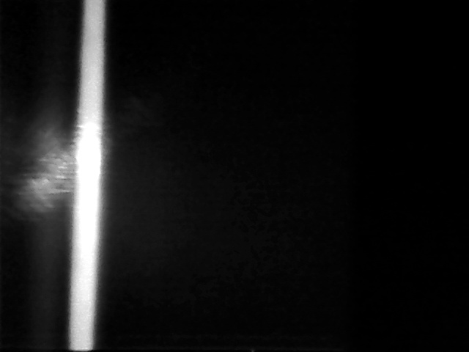
Problems…
Finding pixel displacement for layer height less than 2mm
Finding pixel displacement for bigger object (>30mm)

Slide 9
Next Steps…
From the depth map and camera intrinsics point clouds need to calculated with better accuracy (Need some more data)
Start creating a printed layer comparison algorithm

Slide 10
References
Muñoz-Rodríguez, J. A., & Rodríguez-Vera, R. (2003). Evaluation of the light line displacement location for object shape detection. Journal of Modern Optics, 50(1), 137-154.

Slide 11




Thanks!
#UofGWorldChangers
@UofGlasgow

